Slide 1
The Greek participation
in the European communication campaign “Europe in my Region”

Slide 3
Open EU Project Days in Greece
26 public events
in Athens and 9 Regions

Slide 4
Open EU Project Days in Greece
Organisers
Ministry For Economy, Development and Tourism - National Coordination Authority for the ESIF
The Managing Authorities of the Regions:
Eastern Macedonia Thrace, Epirus, Thessaly,
Ionian Islands, Western Greece, Central Greece,
Northern Aegean, Peloponnesus, Crete

Slide 5
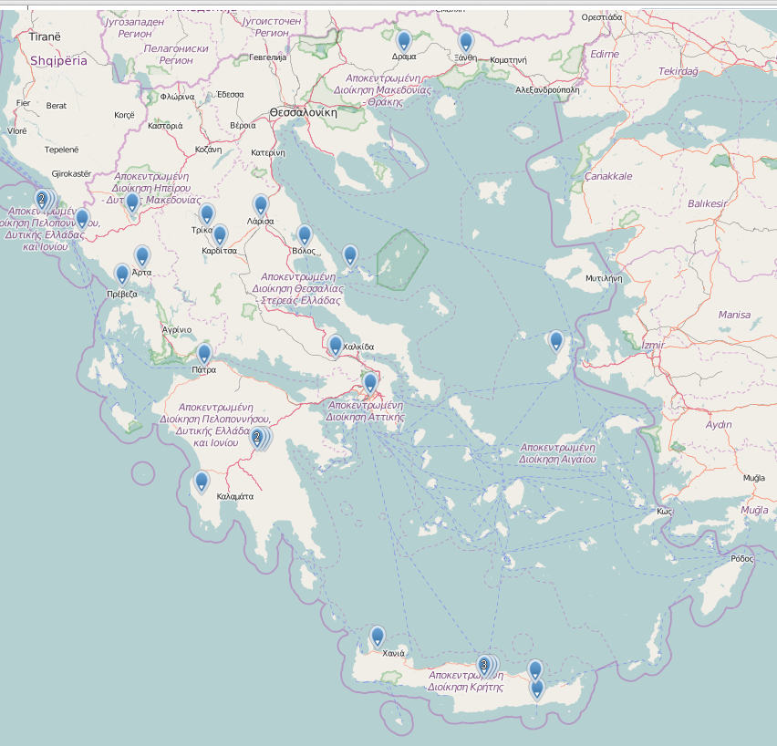
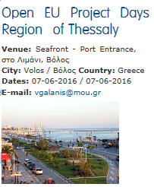
Website EU - DG Regional & Urban Policy map of events, Greece

Slide 6
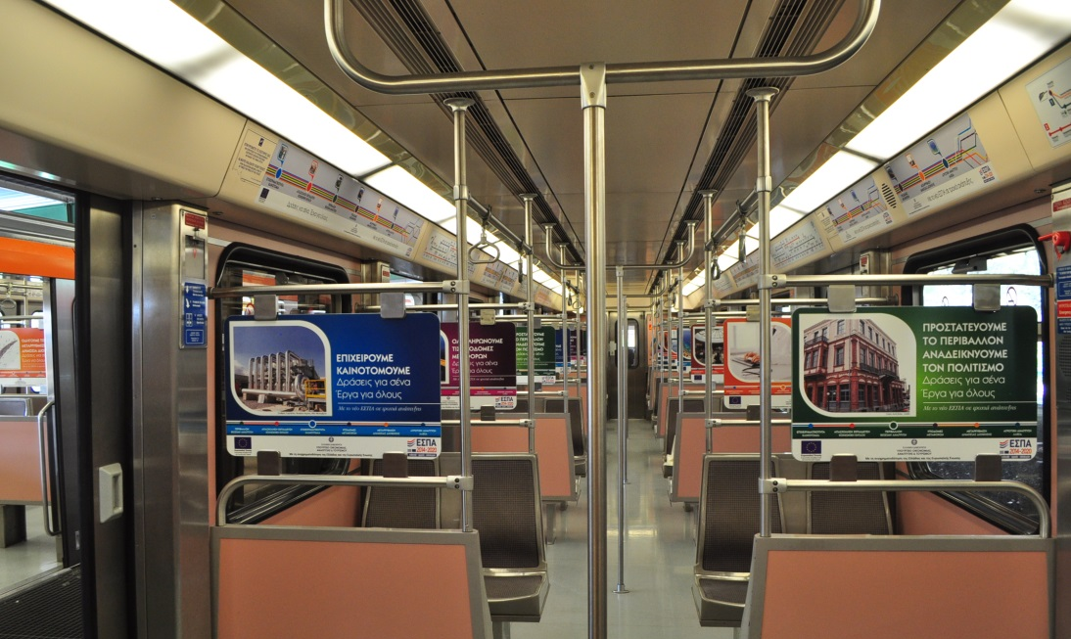
Ministry of Economy, Development &Tourism - 2 events
Athens, Metro Trains

Slide 7
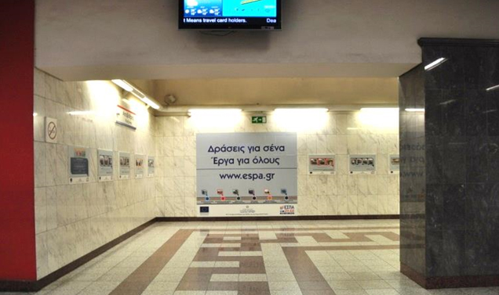
Ministry of Economy, Development &Tourism - 2 events
Athens, Metro Station Syntagma

Slide 8
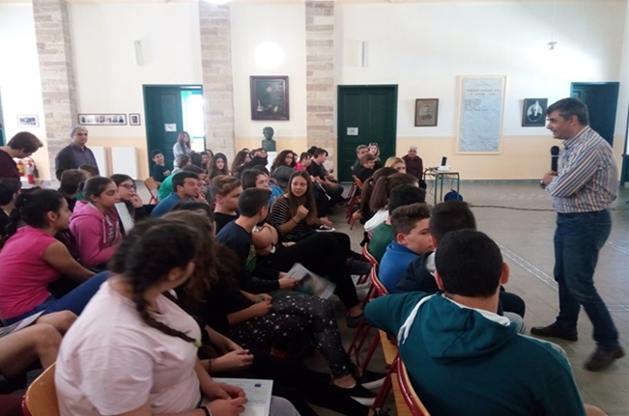
Region of Northern Aegean
Chios, 1st High School

Slide 9
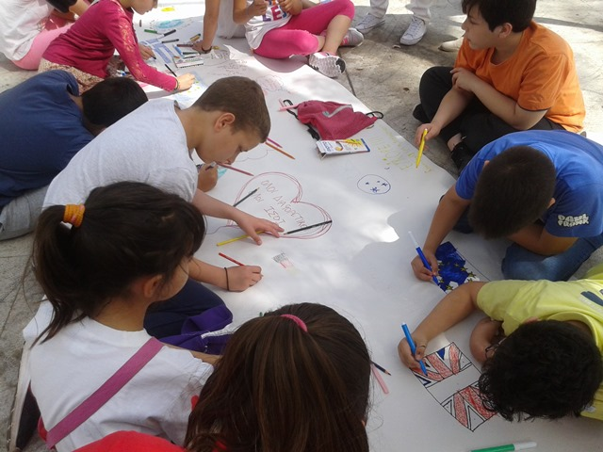
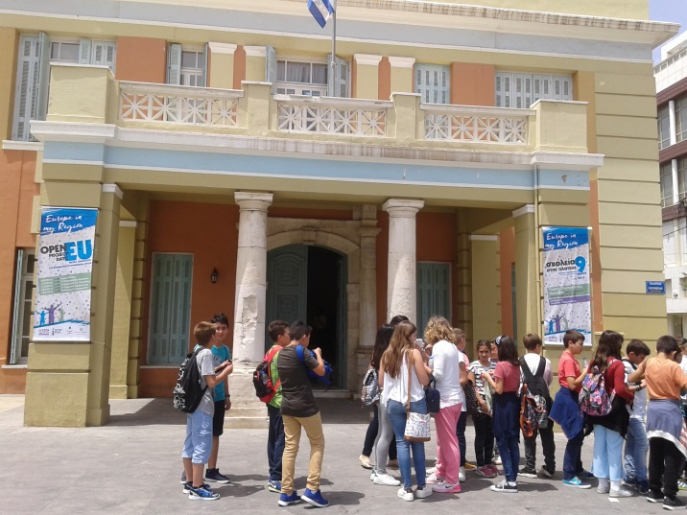
Region of Crete – 6 events
Heraklion, Eleftherias Square

Slide 10
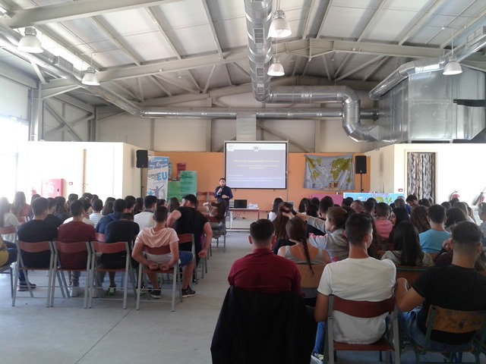
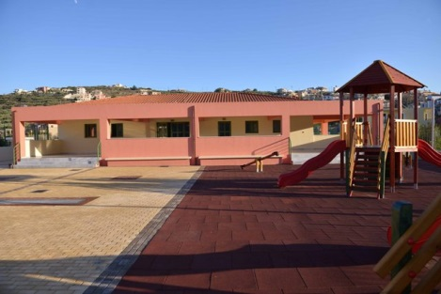
Region of Crete – 6 events
Heraklion, Ierapetra, Chania, Agios Nikolaos - Events in Schools

Slide 11
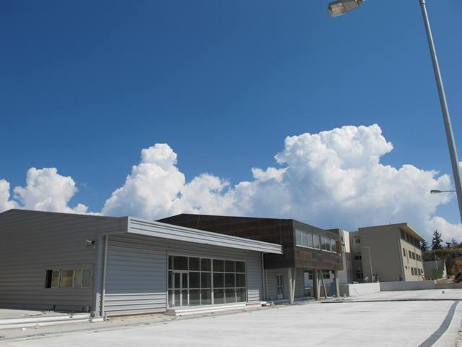
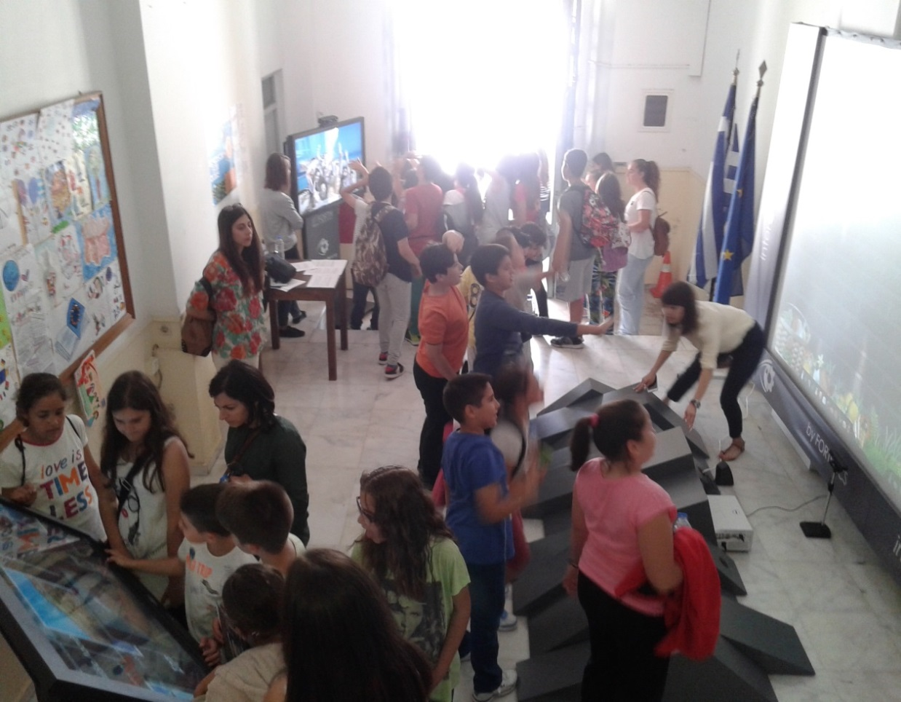
Region of Crete – 6 events
Heraklion, Ierapetra, Chania,
Agios Nikolaos - Events in Schools

Slide 12
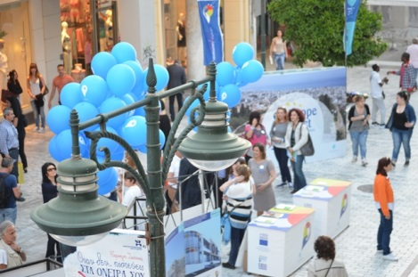
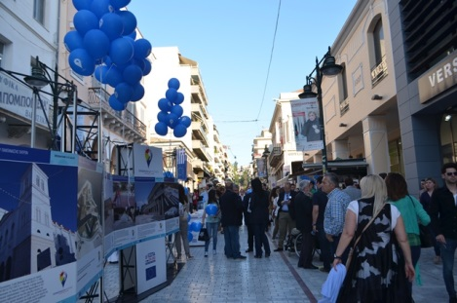
Region of Western Greece
Event in Patras

Slide 13
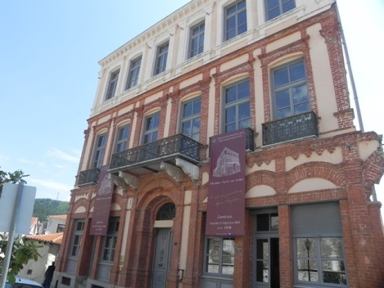
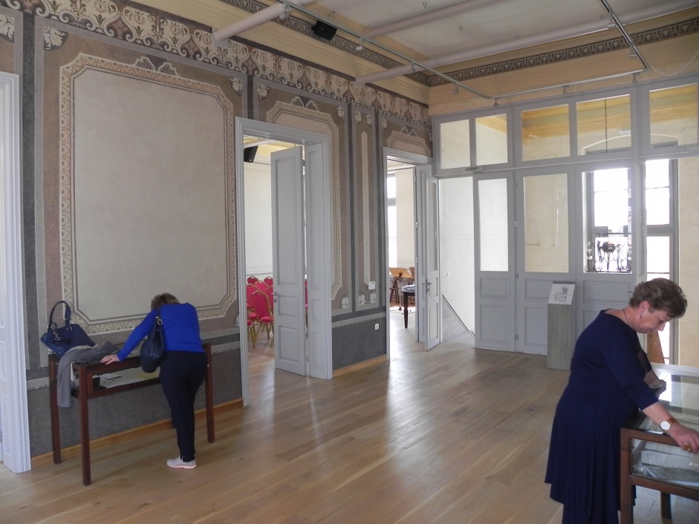
Region of Eastern Macedonia and Thrace - 2 events
Xanthi, The Old Fortress - Manos Hatzidakis residence

Slide 14
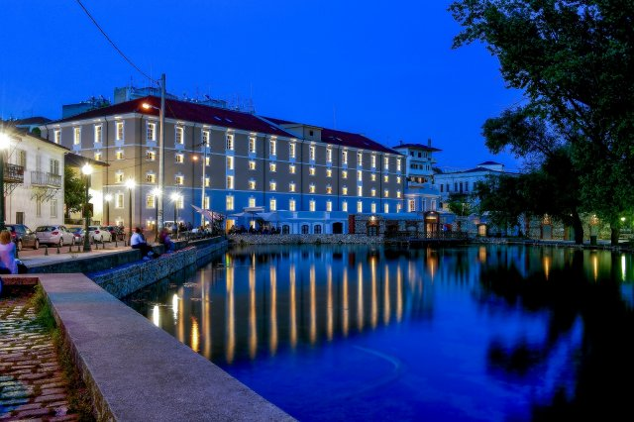
Region of Eastern Macedonia and Thrace - 2 events
Drama, Hydrama Grand Hotel, JESSICA Project

Slide 15
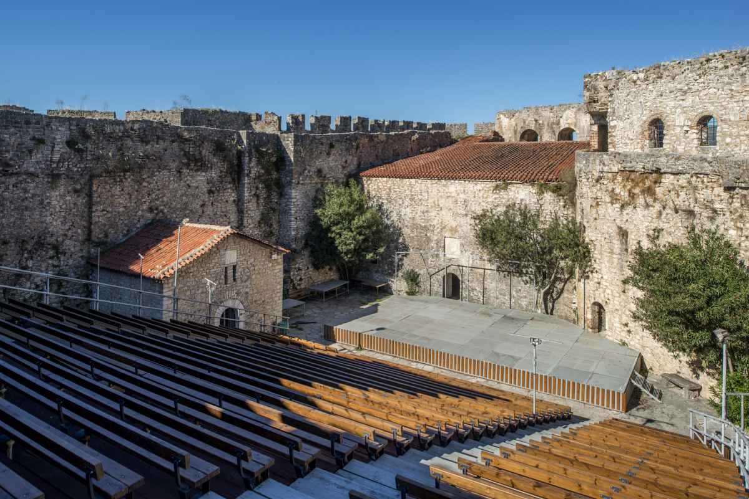
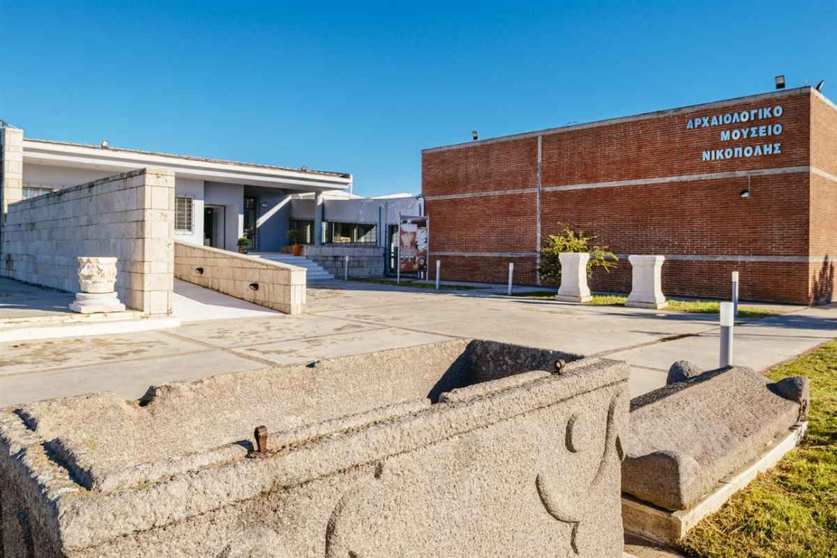
Region of Epirus - 4 events
Arta, The Castle
Preveza, The Nicopolis Museum

Slide 16
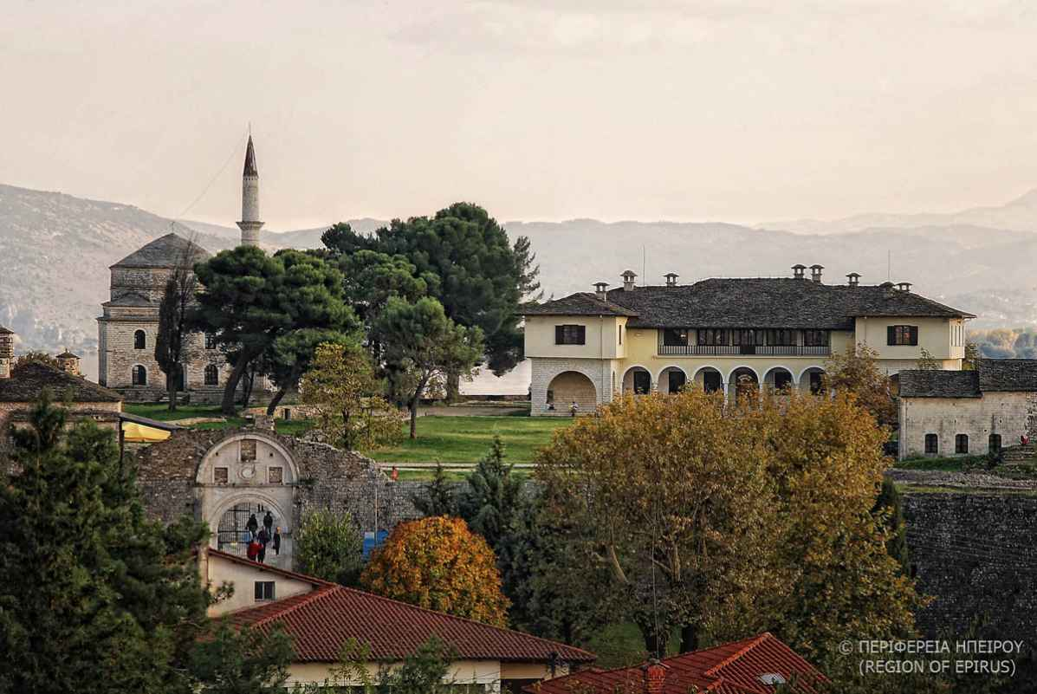
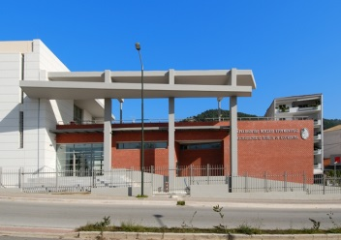
Region of Epirus - 4 events
Ioannina, The Castle
Igoumenitsa,
The Archaeological Museum

Slide 17
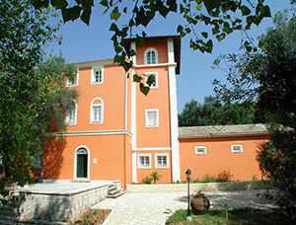
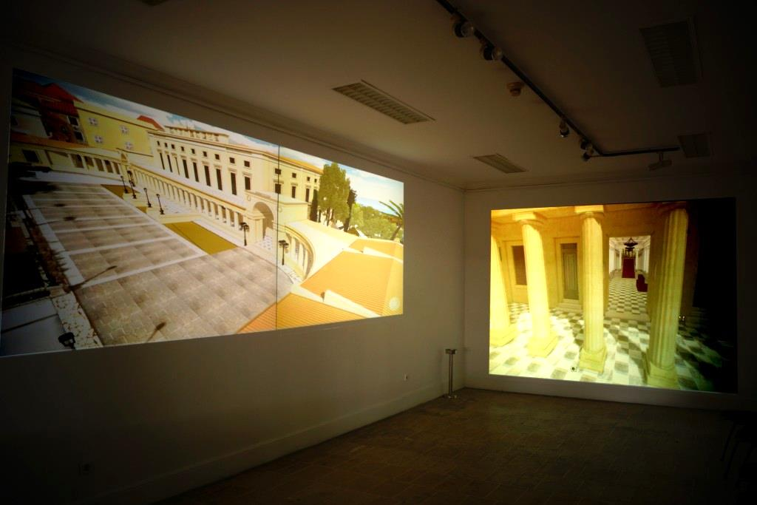
Region of Ionian Islands -
2 events
Corfu, The National Gallery Annex

Slide 18
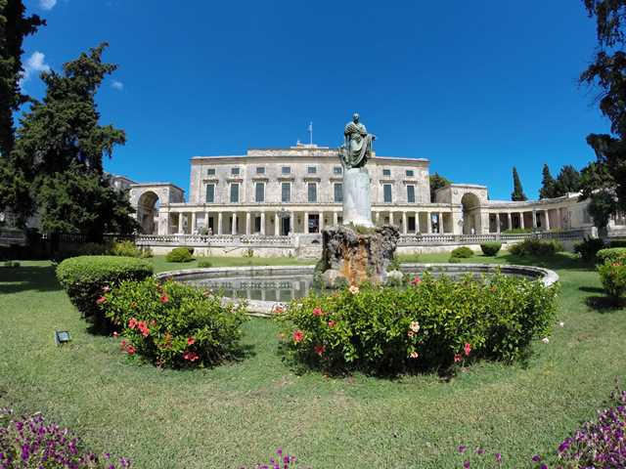
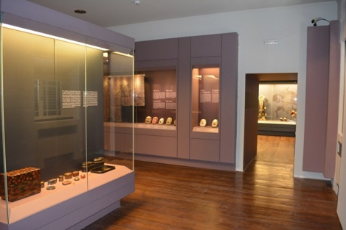
Region of Ionian Islands -
2 events
Corfu, The Museum of Asian Art

Slide 19
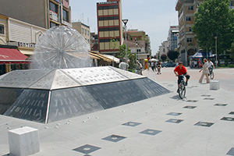
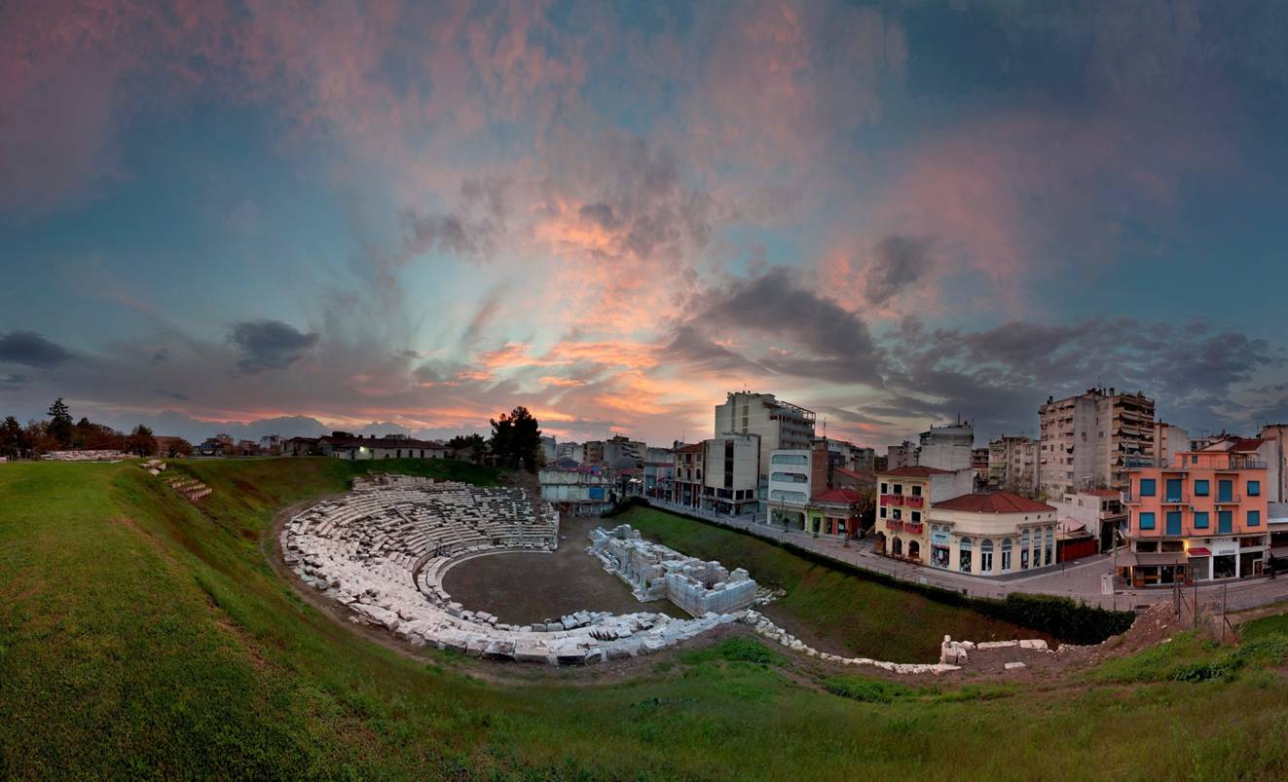
Region of Thessaly - 5 +1 events
Karditsa, Central Square
Larissa, Around the Ancient Theatre

Slide 20
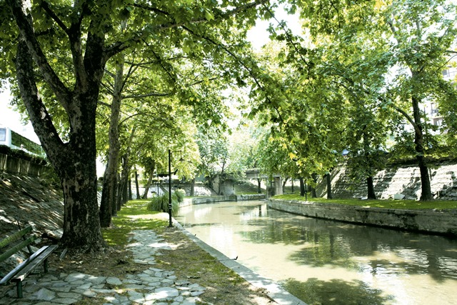
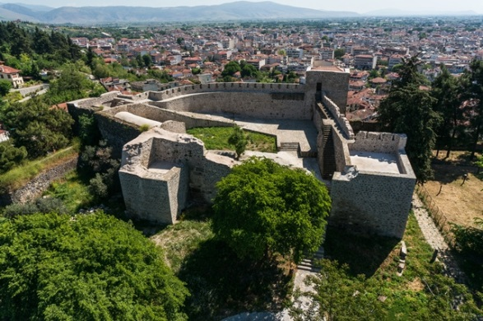
Region of Thessaly - 5 +1 events
Trikala, The Litheos Park
Trikala, The Castle

Slide 21
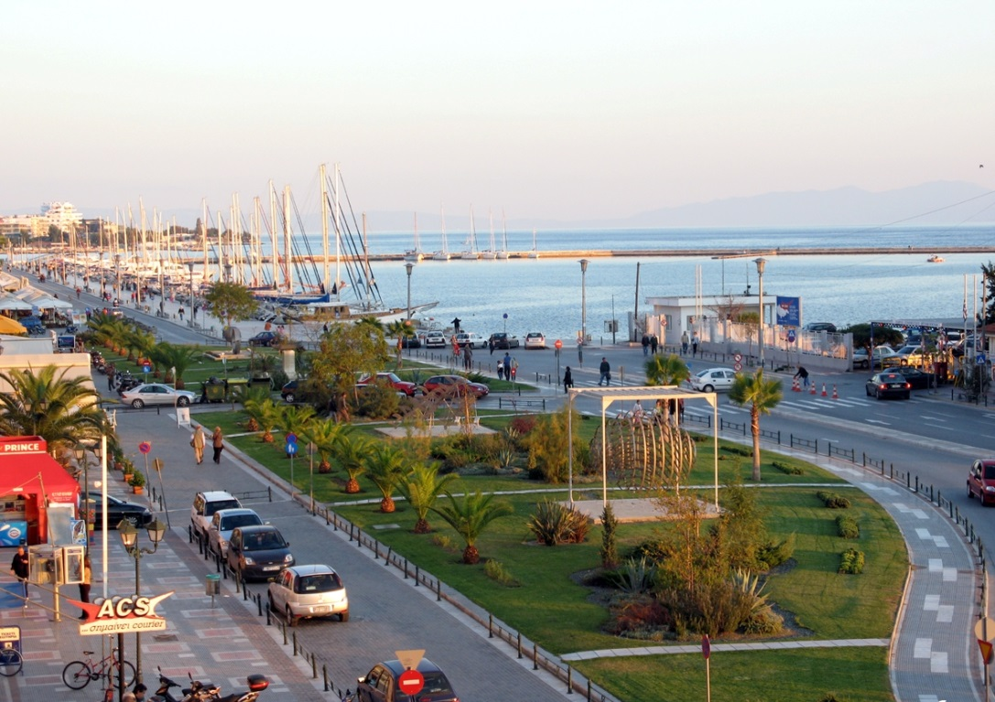
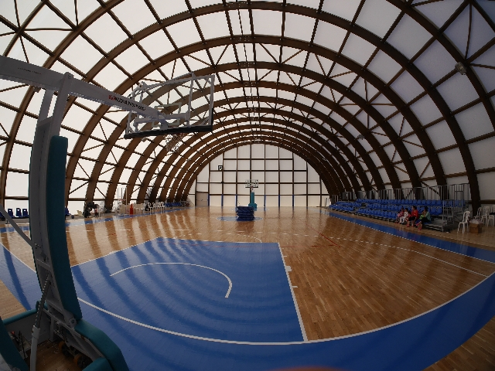
Region of Thessaly - 5 +1 events
Volos, The Port entrance
Skiathos, The Basketball court

Slide 22
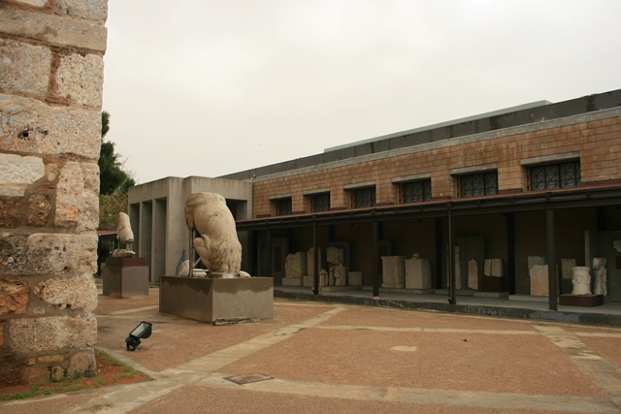
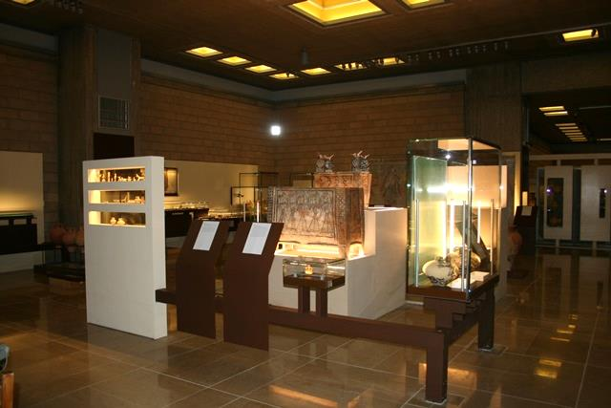
Region of Sterea Ellada
Thebes, Archaeological Museum

Slide 23
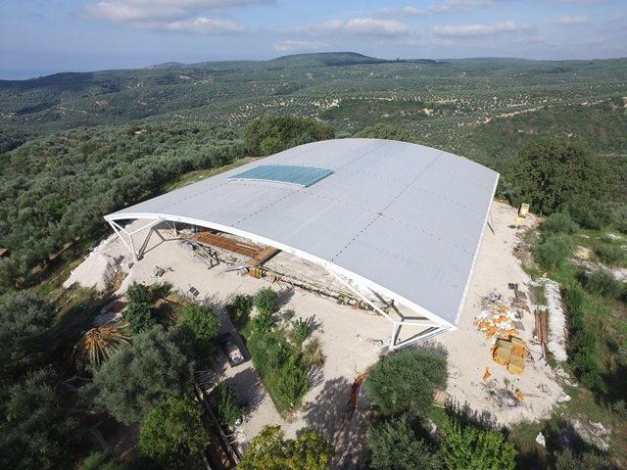
Region of Peloponnissos
3 events
Tripolis, The Music High School
Egkliano, Messinia, Archaeological site of Nestoros Palace

Slide 24
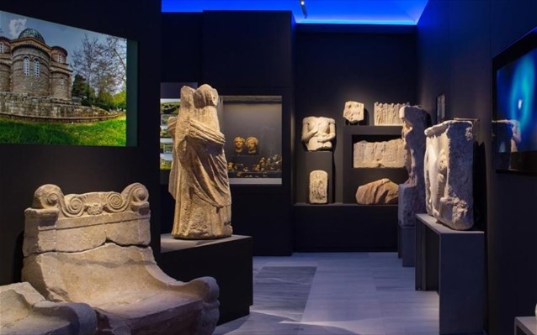
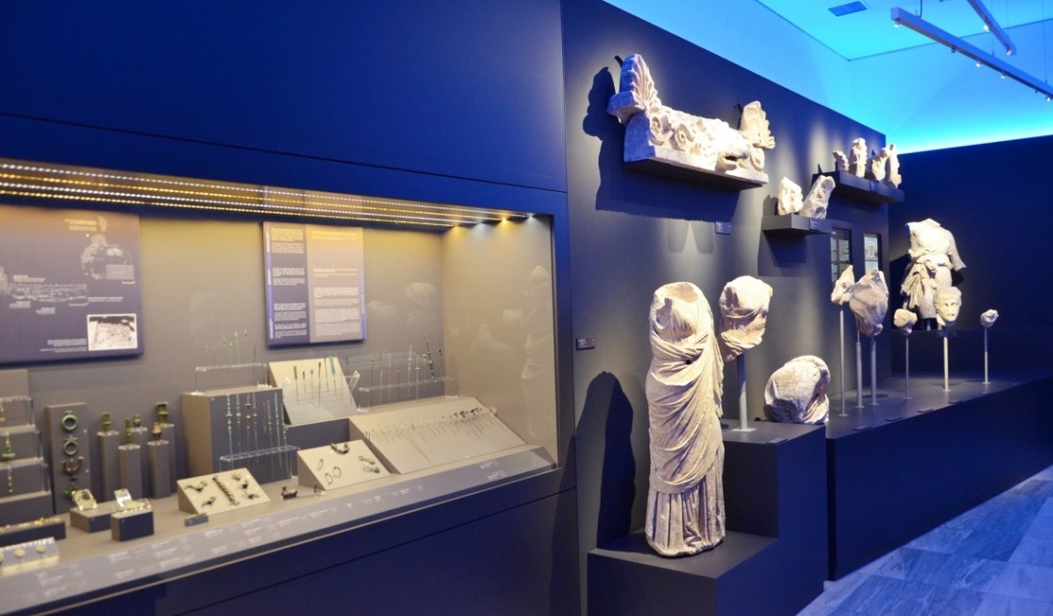
Region of Peloponnissos
3 events
Tegea, Archaeological Museum

Slide 25
The Treasure Hunt
7 Spots in 7 Cities in Greece

Slide 26
Photo Competition &
Bloggers Campaign
Disseminated through the national portal www.espa.gr
& all OPs websites

